Slide 1
So You Want to Start an Undergraduate Statistics or
Data Science Program?
Panelists:
Christopher Malone
Judith Canner
Albert Y. Kim
Kimberly Roth
Moderator:
Lisa Carnell

Slide 2
Please Introduce Yourself
Where you work
What your role is
Stats and/or data science programs offered at your university

Slide 3
Dr. Christopher Malone
School
Winona State University (1 of 7 4-year public institutions in MN)
About 7500 students; Primarily Undergraduates
Dept of Math & Stat
9 MATH; 4 MATH ED; 7 STAT/DSCI
Programs
STAT Major & Minor (1980s)
DSCI Major & Minor (2014)
Personal
Professor of STAT & DSCI
Trained as statistician
Passion: Undergraduate curriculum development

Slide 4
Dr. Judith Canner, Statistics Program Coordinator
California State University, Monterey Bay
4-year Public University
~7200 Undergraduates Students
50% First-Generation
50% URM
Current Programs
Bachelor of Science in Statistics
Statistics Minor
Bachelor of Science in Computer Science with a Data Science Concentration
Planned Programs
Data Science Minor
Personal Information
Associate Professor of Statistics
Mathematics and Statistics Department
PhD Biomathematics and Zoology
My goal in coming to CSUMB was to start a Statistics program. I started the Statistics minor (2011) and then established a concentration within the Math major (2015) and now we have a Statistics major (2019).
https://csumb.edu/math/statistics-bs
I also oversee a grant to support biomedical data science at CSUMB https://csumb.edu/bd2k

Slide 5
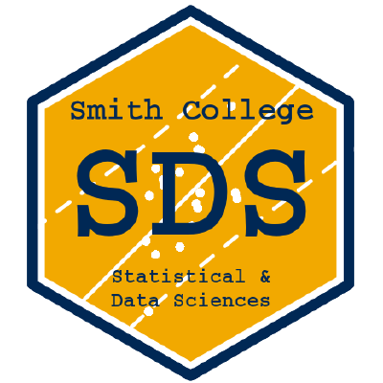
Dr. Albert Y. Kim
Assistant Professor of Statistical and Data Sciences at Smith College
Small women’s liberal arts college (~2500 students)
Independent from MATH & CS
Grads 2018-2020: 10 -> 21 -> 35
FTE’s:
3 full-time SDS
3 + {1 new} joint with SDS: MATH, CS, PSY, {GOV}
We offer
Major in SDS
Minors in SDS & Applied Stats
MATH offers statistics track
Early discussions
Joint MATH & SDS major

Slide 6
Dr. Kim Roth, Juniata College
Small (about 1600 students) liberal arts college in central PA
Math professor with statistics training and part of the data science program.
We offer:
Minor in Data Science since Fall 2017
Major in Data Science since Fall 2019
Masters in Data Science starting Spring 2020
Collaboration by math and it/computer science
Notes:
•In Fall 2015 Kim met with the provost to talk about data science and was told it was Loren’s upcoming sabbatical topic for Fall 2016 and we should talk to each other.
•Met with constituent departments in Fall 2015.
•Researched and talked to many programs with help from Gina Lamendella Summer 2016. (Note Park City was 2016, so that wasn’t out yet, we did look at it once it was out)

Slide 7
Timeline and Program Type
How did your university decide to start either a statistics and/or data science program? How did they decide between the two, or both, etc? What are the differences/pros/cons for statistics versus data science programs?
What was the timeline like from first deciding to create a program to the initial implementation?
How do you think the type of university you work for influenced the type of program you offer and timeline? (Liberal arts, large state system, etc) Were there any issues with getting the program approved?
Did you need to hire any new faculty to start your programs? If so, what was the hiring process like? Please discuss the hiring timeline, how you led a successful search, etc.

Slide 8
CSUMB Statistics Program Development
First Course for Statistics Minor Offered
Math with Statistics Concentration Begins
Statistics Major Begins
Statistics Minor Established
Statistics Concentration Sunset
Consulting
Stat Theory 1-2
2010 | 2011 | 2012 | 2013 | 2014 | 2015 | 2016 | 2017 | 2018 | 2019 | 2020
← Recession →
Data Science becomes a thing ---->
Math Stat
Linear Models
Applied Stat Electives
Statistical Computing
First Statistician Hired
Second
Statistician Hired
Third Statistician Hired
New Courses
Hiring
Program Milestones

Slide 9
WSU: DSCI Timeline
[March 2010] Statistics Program Review
[May 2011] Designing an Undergraduate Statistics Degree for the Future
[JSM 2012] Undergraduate Statistics Program of the Future

Slide 10
WSU: DSCI Timeline
[March 2010] Statistics Program Review
[May 2011] Designing an Undergraduate Statistics Degree for the Future
[JSM 2012] Undergraduate Statistics Program of the Future
[MinneAnalytics 2013]: Redesign your next hire: A grassroots effort to create a Data Scientist degree
[CSP 2013]: Modifying the Undergraduate Curriculum to Properly Train Future Data Scientists
[JSM 2013]: The Data Scientist Degree – A Necessity for Growth in our Discipline
[Fall 2014]: DSCI Program launch

Slide 11
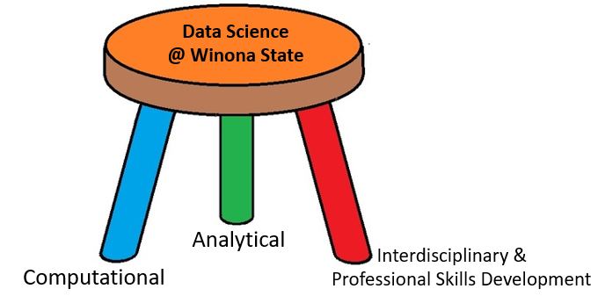
WSU: 3-Legged Stool for DSCI

Slide 12
Program Structure
Can you discuss how you determined the program structure?
For instance, did you utilize the PCMI Curriculum Guidelines for Undergrad Programs in Data Science or the ASA Curriculum Guidelines for Undergraduate Programs in Statistical Science?

Slide 13
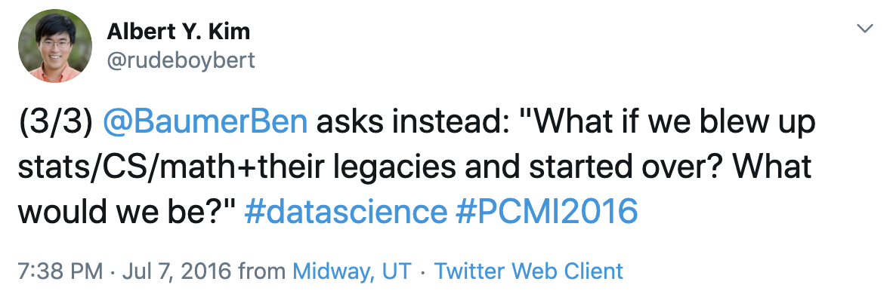
Just trying to capture the spirit of the thing (PCMI)...

Slide 14
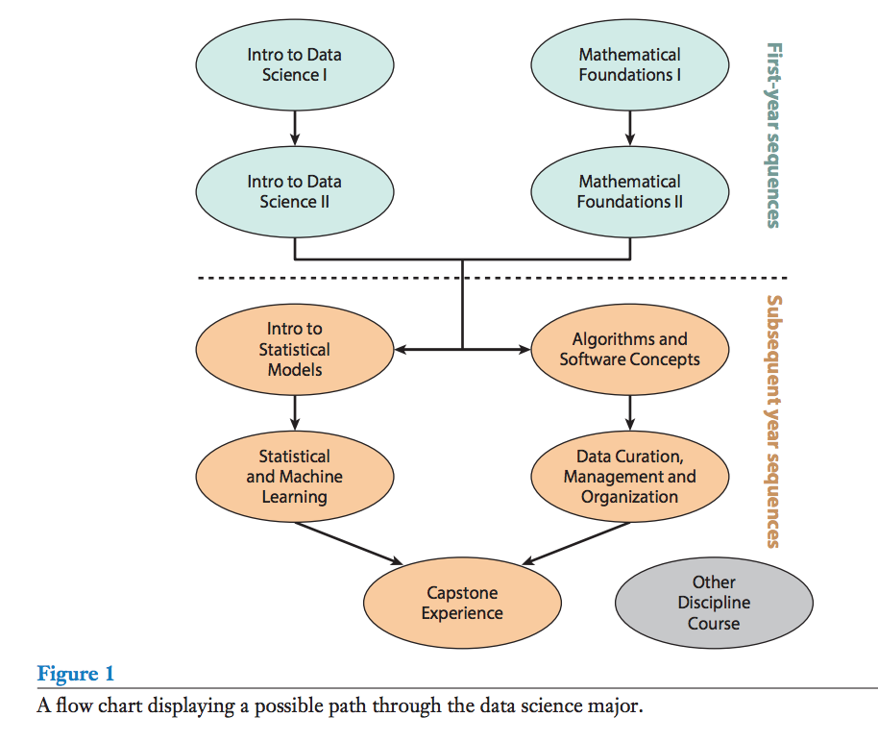
PCMI Flowchart
From “Curriculum Guidelines for Undergraduate Programs in Data Science” available at:
bit.ly/pcmi_datascience

Slide 15
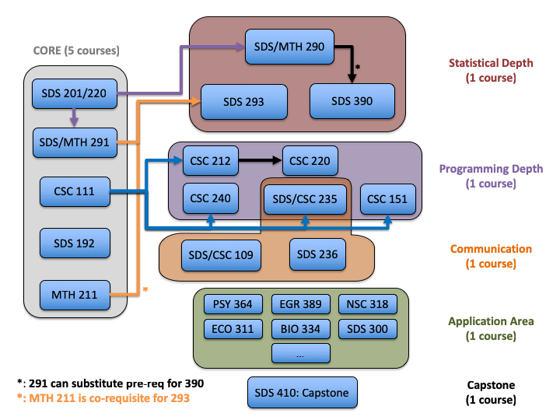
Smith SDS Major
Machine learning, Experimental design, Special topics
Intro stats
Mult regr
CS courses: Data structures, ...
Intro prog
Intro DS
Ex: Communicating w/ Data, Data journalism
Lin alg
NOT in SDS, MATH, or CS
Flowchart
available at:
smith.edu/sds
Projects, projects, projects!

Slide 16
Data science major at Juniata
Lower Levels | Upper Levels | Cognate area
Introduction to Data Science | Database Management Systems | Choice of 12 credits outside data science
Introduction to Statistics | Information Visualization
Computer Science I | Machine Learning
Calculus I | Multivariate Statistics
Linear Algebra | Data Science Consulting/Research with heavy statistics component
Data Acquisition | Big Data
https://www.juniata.edu/registrar/poes/data-science.php

Slide 17
ASA Curriculum Guidelines and CSUMB MLOs
ASA Guidelines | Major Learning Outcome (MLO) | Courses
Mathematical Foundations | MLO 1: Mathematical and Statistical Theory Based on mathematical foundations, students demonstrate the ability (i) to interpret theoretical statistical statements, (ii) to communicate statistical ideas using mathematical language, and (iii) to address research questions using statistical theory. | Calculus 1-3 Linear Algebra Discrete Math Statistical Theory 1-2
Statistical Methods and Theory | MLO 2: Statistical Methods Students demonstrate the ability to follow the statistical investigative process to formulate an answerable research question, collect, manipulate, and explore data, and analyze and conduct inference via statistical models. | Applied Probability and Statistics Generalized Linear Models Statistics Electives

Slide 18
ASA Curriculum Guidelines and CSUMB MLOs
ASA Guidelines | Major Learning Outcome (MLO) | Courses
Data Wrangling and Computation | MLO 3: Data Manipulation and Computation Students demonstrate the ability to manage and manipulate data, use multiple programming languages, answer research questions through appropriate software coding, and perform basic statistical computation. | Introduction to Programming (C++) Statistical Computing (R, SAS) Integrated throughout all courses WE NEED SQL!

Slide 19
ASA Curriculum Guidelines and CSUMB MLOs
ASA Guidelines | Major Learning Outcome (MLO) | Courses
Statistical Practice | MLO 4: Statistical Practice and Communication Students demonstrate the ability to communicate with collaborators effectively and respectfully. Students are able to adjust their use of language depending on the collaborators’ backgrounds, to practice ethics (particularly for human-subject data), to understand (or reformulate) a research question (or a project goal), and to implement appropriate statistical methods. Students are able to produce an informative report, both written and oral, which is easily readable by the target audience. Students engage in ethical reasoning and public action through their profession to promote social justice and equity. | Major Professional Seminar Service Learning for Math/Stat Consultants Capstone Seminar Course-based Research Projects in all upper-division courses.

